Slide 1
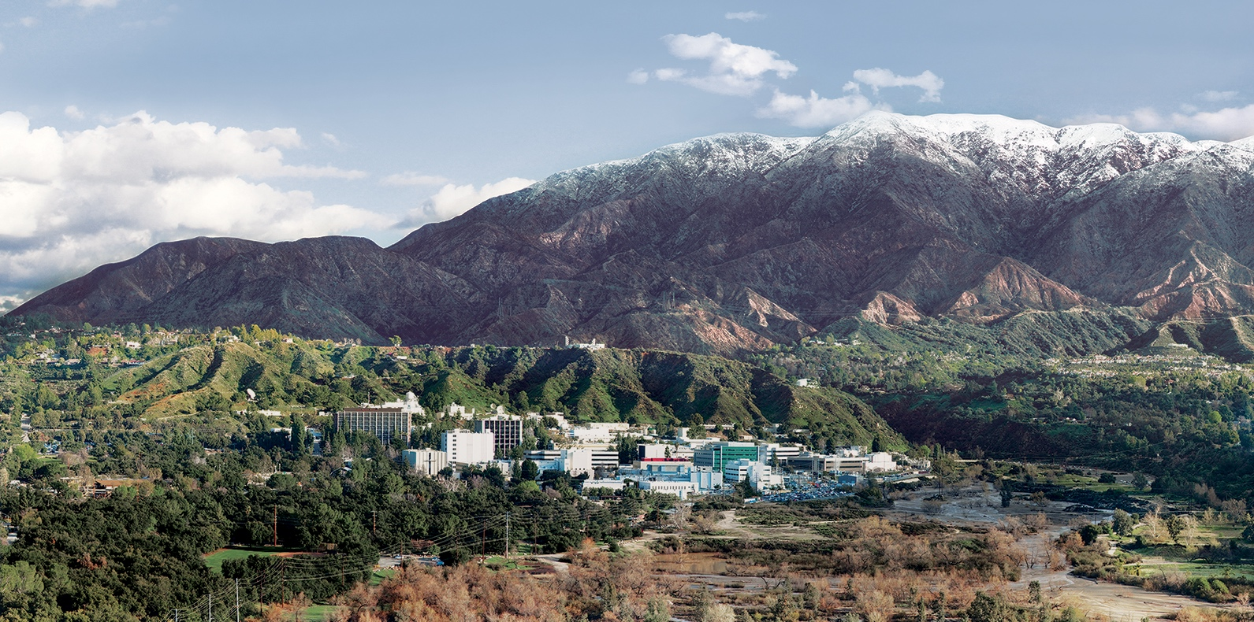
4. Noise and Dimensionality
Dr. David R. Thompson
Jet Propulsion Laboratory, Imaging Spectroscopy Group

Slide 2
Goals for this module
Understand, calculate, and interpret the intrinsic spectral dimensionality
Use PCA to compress imaging spectroscopy data

Slide 3
The intrinsic dimensionality represents the true degrees of freedom in the measured process.
channel 2
channel 1
This can be a measure of spectral diversity.

Slide 4
In a natural physical system, random measurement noise can inflate the apparent dimensionality
Ideal measurement
Realized measurement
channel 2
channel 2
channel 1
channel 1

Slide 5
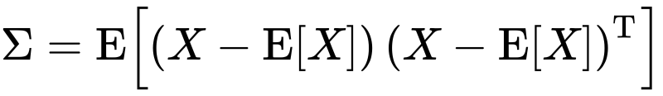
To estimate the intrinsic dimensionality measurable above the noise, look at the eigenvalues of the covariance matrix. Apply Singular Value Decomposition:
U is a valid orthonormal basis
Diagonal matrix of singular values

Slide 6
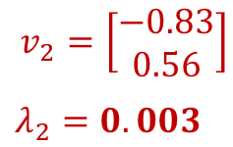
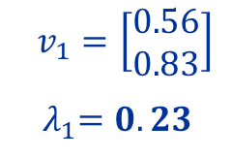
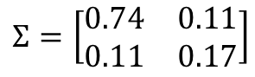
To estimate the intrinsic dimensionality measurable above the noise, look at the eigenvalues of the covariance matrix.
$$Σ=\left[\begin{matrix}0.74 & 0.11 \\ 0.11 & 0.17\end{matrix}\right]$$
channel 2
$$v_{1}=\left[\begin{matrix}0.56 \\ 0.83\end{matrix}\right]$$
${ λ}_{1}=0.23$
Only one significant eigenvalue
$$v_{2}=\left[\begin{matrix}−0.83 \\ 0.56\end{matrix}\right]$$
$λ_{2}=0.003$
channel 1

Slide 7
This eigenvalue decay curve tells you how many dimensions are “significant.”

Slide 8
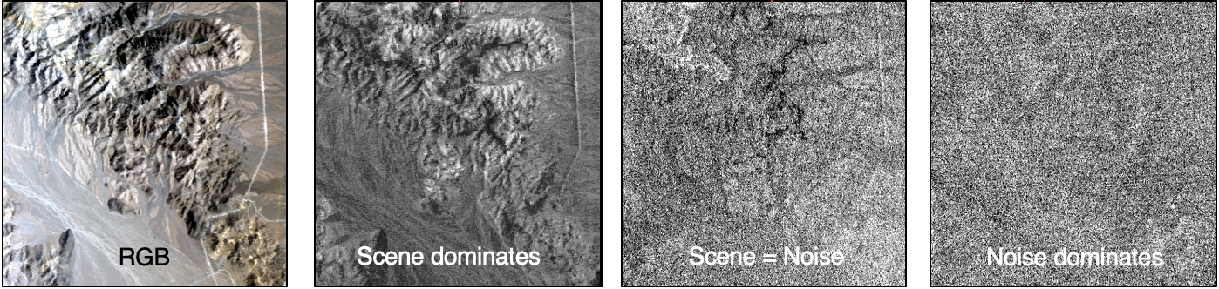
One way to find the noise level: project the data onto each eigenvector. Where does uncorrelated noise dominate?
We can define this dataset as having an intrinsic dimensionality of 24.
eigenvalue
component #
10
24
32
AVIRIS-C Overflight of Ivanpah Playa, 31 Mar 2014

Slide 9
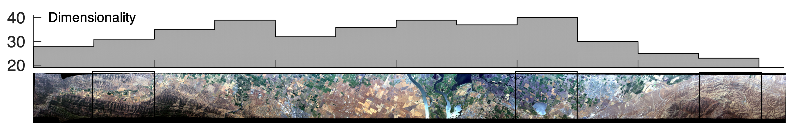
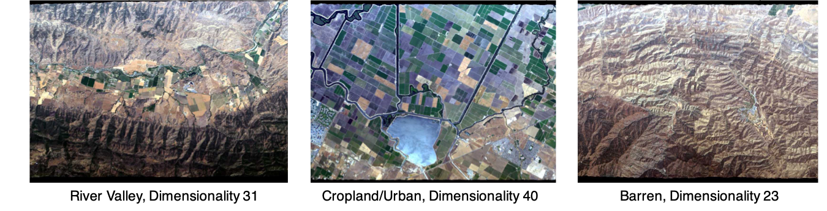
Example from “AVIRIS Classic” Instrument

Slide 10
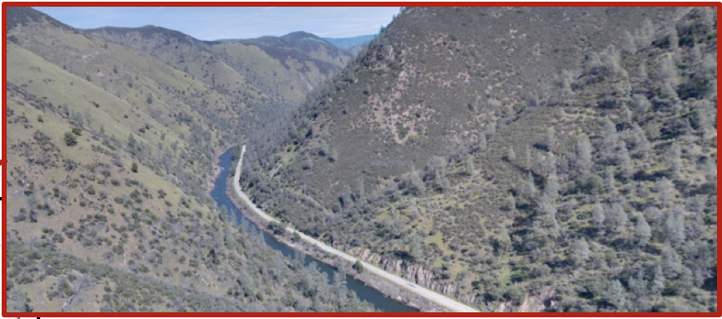


The Spectral Dimensionality of California
[Thompson et al., Optics Express 2016]
Images: Google / NASA / Sierra Nevada Photo by DAVID ILIFF. License: CC-BY-SA 3.0
Dimensionality
Spring 2013

Slide 11
Principal component analysis
Finds new basis for efficiently representing data using vectors of a lower dimension, focusing on the linear subspace spanned by the process you are measuring. It finds the projection that maximizes the variances (i.e. the spread) of the projected dataset. The basis is given by the eigenvectors of the covariance matrix:
$$Σ=\left[\begin{matrix}0.74 & 0.11 \\ 0.11 & 0.17\end{matrix}\right]$$
$$Σ=\left[\begin{matrix}0.74 & 0.11 \\ 0.11 & 0.17\end{matrix}\right]$$
First eigenvector
$$v_{1}=\left[\begin{matrix}0.56 \\ 0.83\end{matrix}\right]$$
${ λ}_{1}=0.23$
channel 2
channel 2
Second eigenvector
$$v_{2}=\left[\begin{matrix}−0.83 \\ 0.56\end{matrix}\right]$$
$λ_{2}=0.003$
channel 1
channel 1

Slide 12
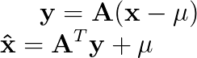
PCA Recipe
Convert the data to have zero mean
Form A using the top n eigenvectors of the sample covariance matrix XX^{T} . Equivalently, you can use the left singular vectors of X associated with the largest singular values
Project the data:
To reconstruct:
$$Σ=\left[\begin{matrix}0.74 & 0.11 \\ 0.11 & 0.17\end{matrix}\right]$$
$$Σ=\left[\begin{matrix}0.74 & 0.11 \\ 0.11 & 0.17\end{matrix}\right]$$
First eigenvector
$$v_{1}=\left[\begin{matrix}0.56 \\ 0.83\end{matrix}\right]$$
${ λ}_{1}=0.23$
channel 2
channel 2
Second eigenvector
$$v_{2}=\left[\begin{matrix}−0.83 \\ 0.56\end{matrix}\right]$$
$λ_{2}=0.003$
channel 1
channel 1

Slide 13
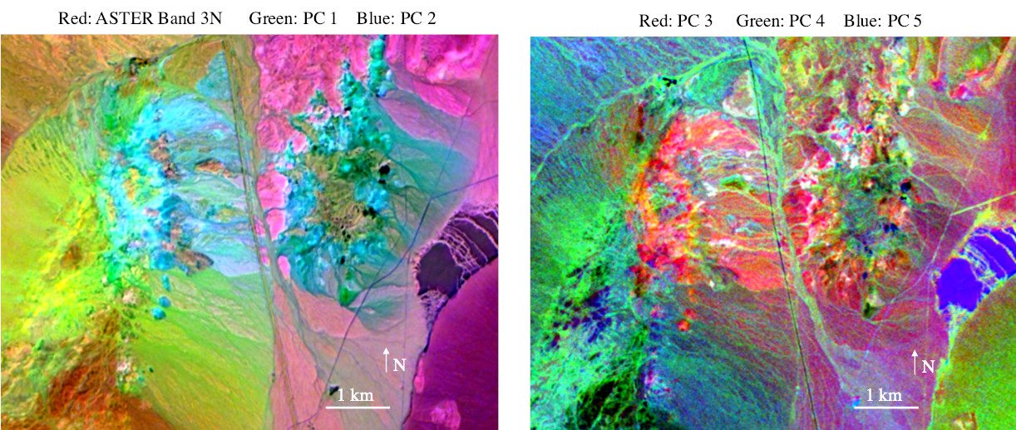
First 5 PCA dimensions of the of Cuprite Nevada mining district (AVIRIS-NG)
[Thompson et al., Astrobiology 2019]

Slide 14
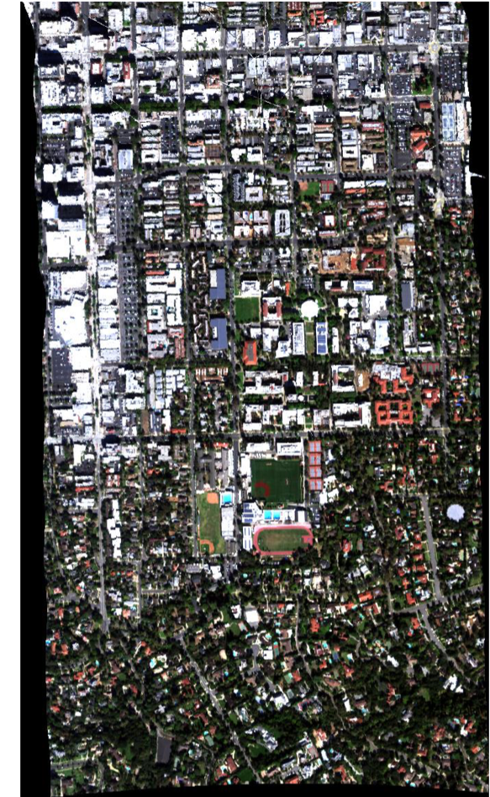
Practical Considerations: Bad data values
Most spectral data cubes have some locations for which spectra are invalid because of geoprojection effects, instrument configurations, etc.
In our system, these are flagged with floating point values of -9999. Be sure to exclude these locations from your statistics!
Note: bad data around margin due to geoprojection

Slide 15
Practical Considerations: Interleave
Spectral data cubes have three dimensions, leading to several potential index orderings.
The most common are:
Band Interleaved by Pixel (BIP): x[ row, column, channel ]
Band Interleaved by Line (BIL): x[ row, channel, column ]
Band Sequential (BSQ): x[ channel, row, column ]
Most data cube header files indicate the interleave as an ASCII text string. We store ours in BIL format, but occasionally translate to BIP for cleaner indexing syntax.

Slide 17
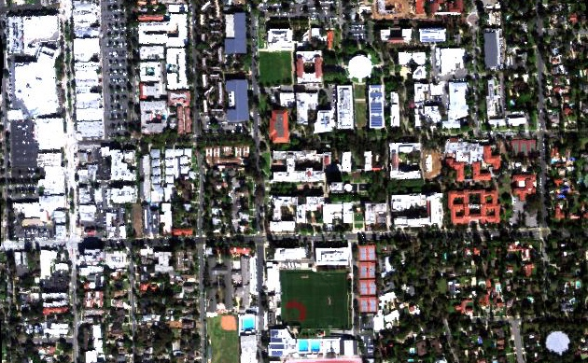
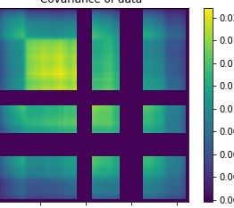
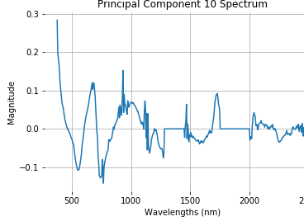
Exercise 4: Principal Component Analysis
N
100 m
Objective: Calculate Principal Components of the Caltech cube. Calculate mean spectra and the covariance matrix. Watch out for deep water features and bad data flags (values of -9999) at the periphery. You may not need all spectra in the calculation. Are any of the top PCs interpretable? If so, what do they represent?

Slide 18

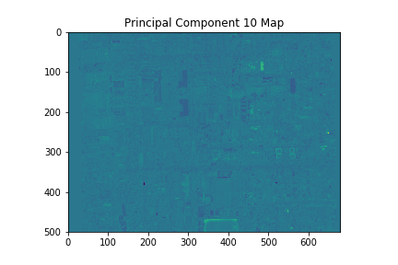
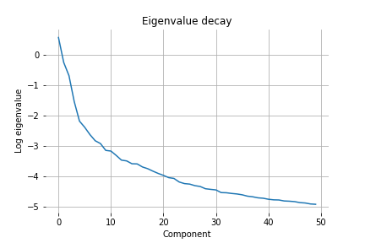
Bonus: Intrinsic dimensionality
N
Objective: Find the intrinsic dimensionality of the Caltech cube. Calculate principal components as before, and evaluate the eigenvalue decay. There are several ways one might find the noise level. For example:
Project each mean-removed spectrum onto the eigenvectors to make spatial maps. Then, visually determine the eigenvalues for which the spatial projection starts degenerating to noise.
Find a spatially-homogeneous area and use pixelwise differencing methods. I haven’t actually tried this yet, and it might be challenging due to the nature of the scene.
100 m

